Slide 1


Slide 2

Pronounced JEE-RAH, like SHE-RA (Princess of Power)

Slide 3

Pronounced JEE-RAH, like SHE-RA (Princess of Power)

Slide 4


Slide 5
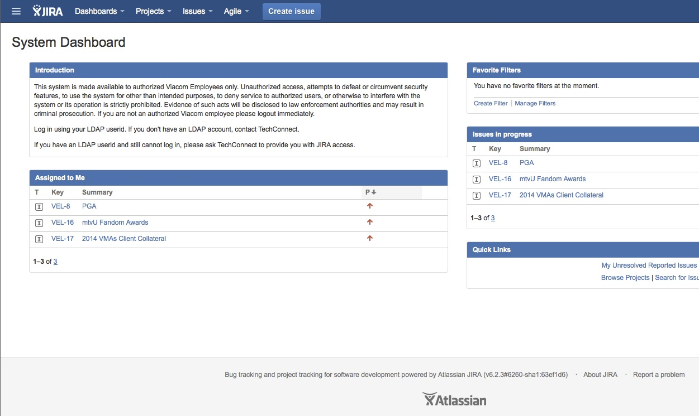

Slide 6
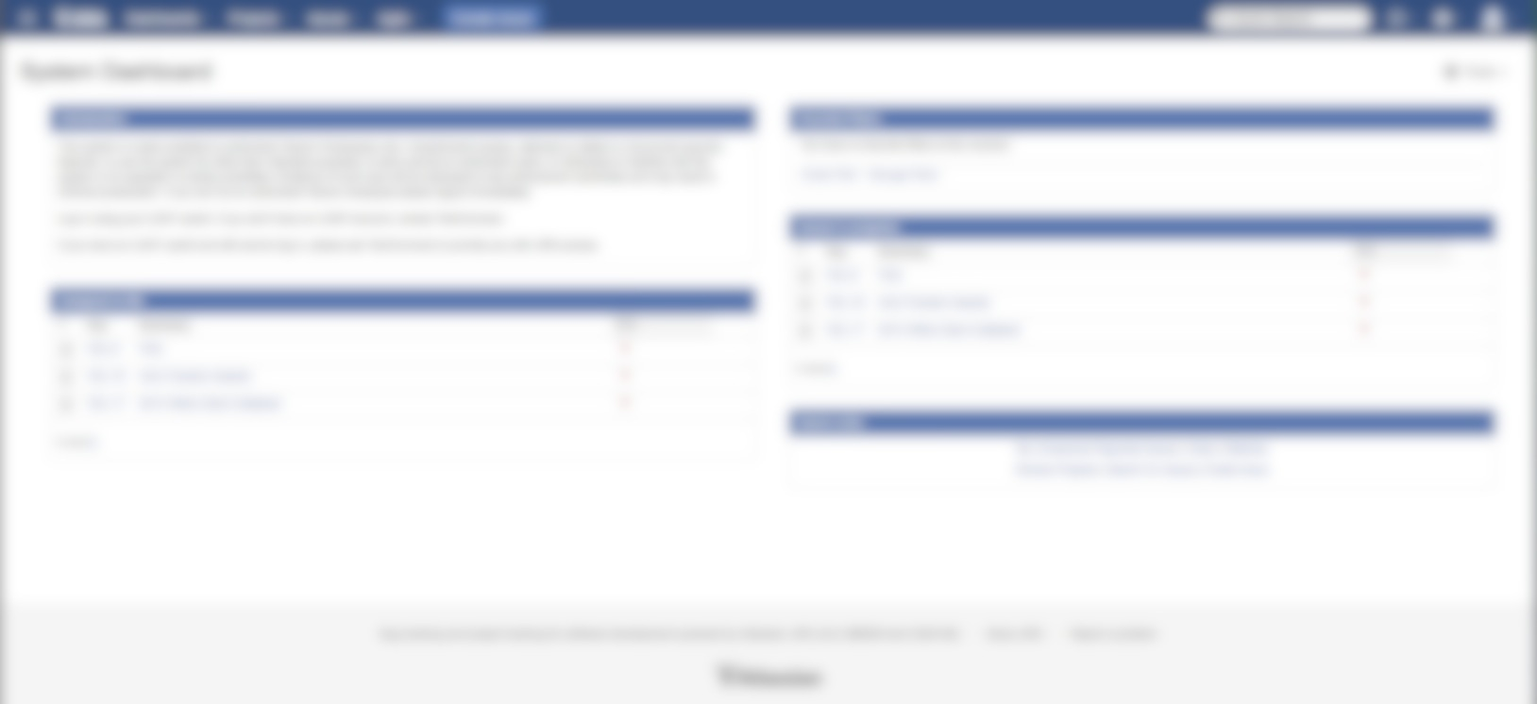

Slide 7


Slide 9

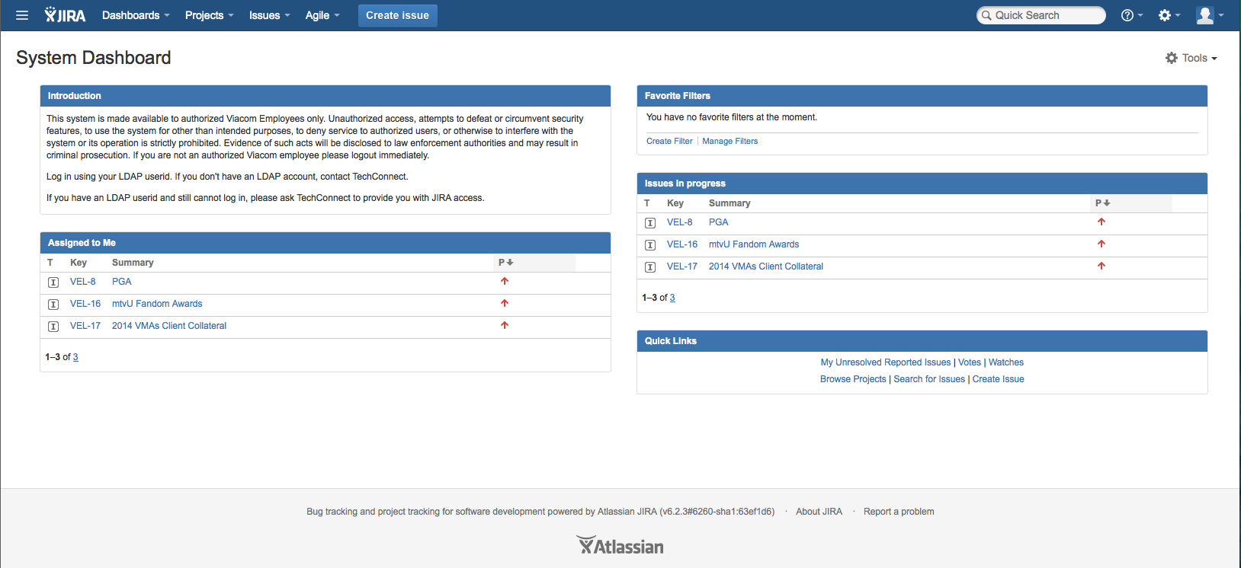
What you’ll be interacting the most with in Jira is the Velocity Projects board (aka our project management page). To get there, open the drop-down menu in the tab at the top of the page labeled Agile.

Slide 10
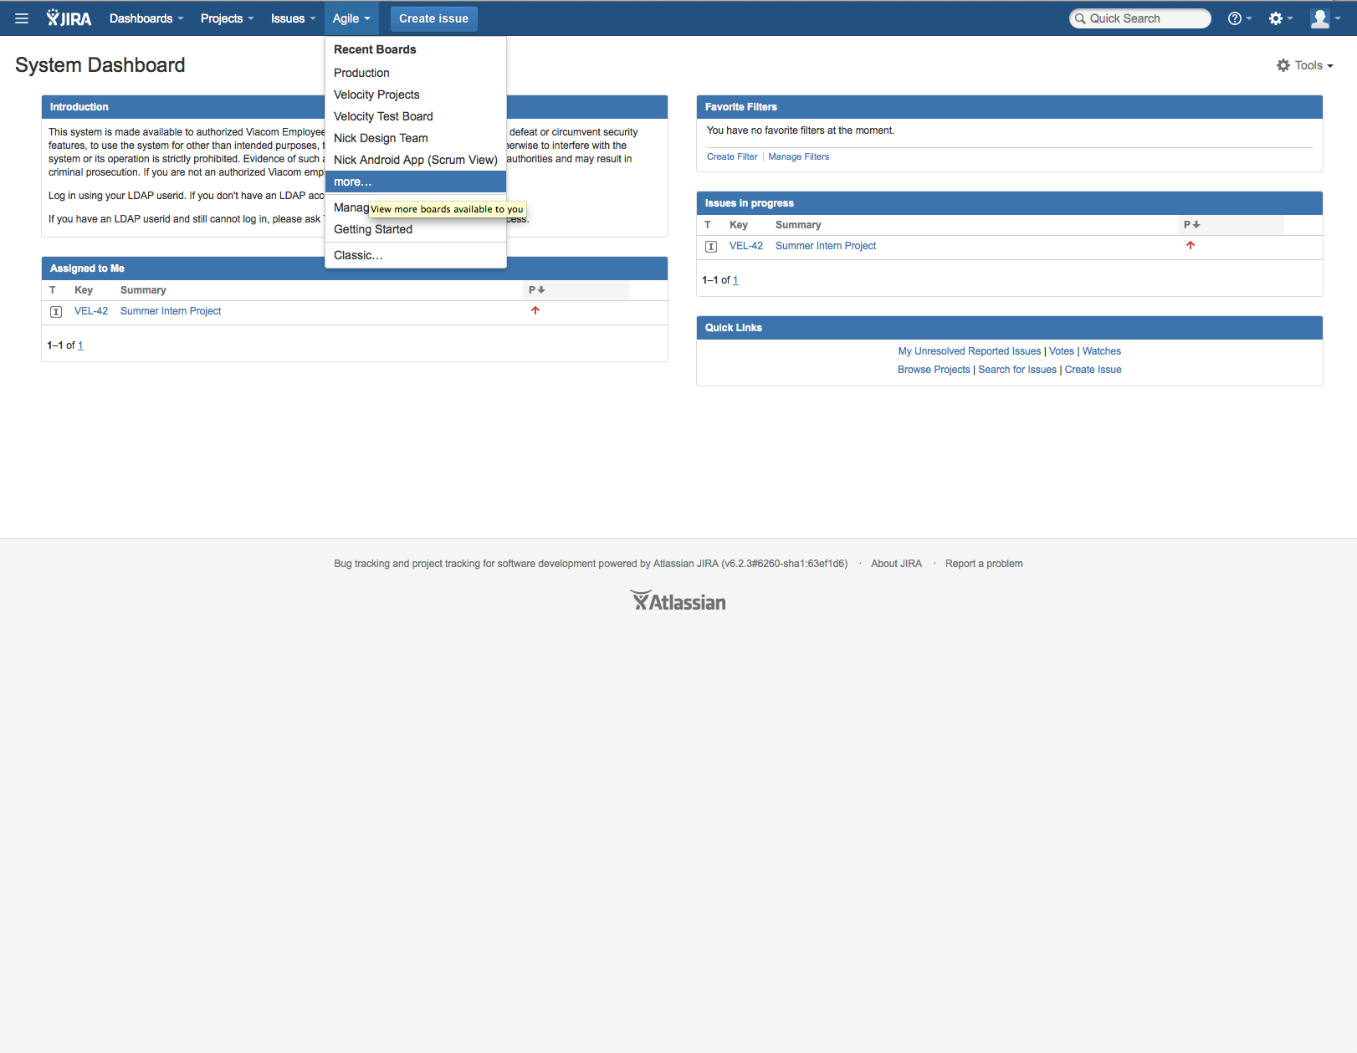
Under the Agile tab, click More…the page will take a second or two (or 60) to load.

Slide 11
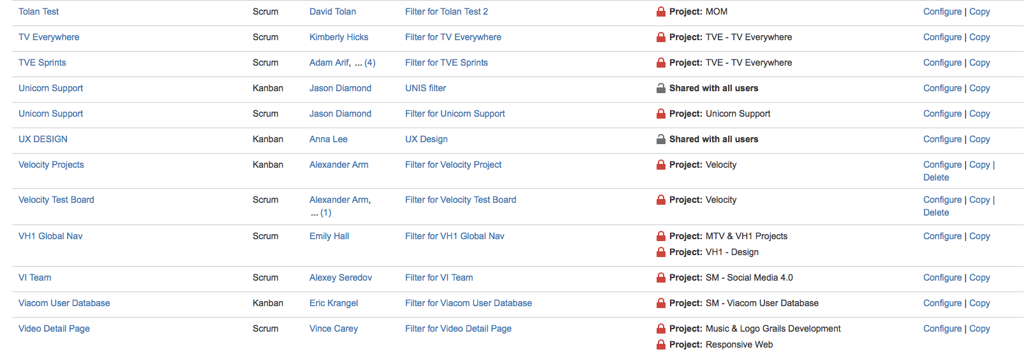
Once the page loads, scroll down until you see Velocity Projects. You will only have to do this once – after you select it, the Velocity Projects page will appear automatically when you click the Agile tab.

Slide 12
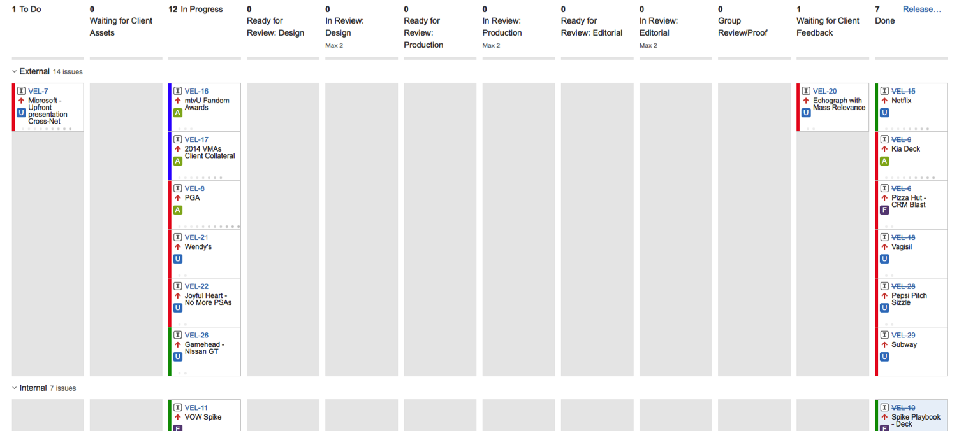
This is where you’ll see all the projects our team is working on, and where you’ll update your projects’ statuses as you complete your work.

Slide 13
You’ll be able to tell your project’s status by which column it’s in. You and the project managers will be able to drag and drop projects between columns once they’ve entered a new stage.

Slide 14
To Do: project hasn’t been started yet
Waiting for Client Assets: project requiring more info from client
In Progress: project underway
Ready for Review (Design, Production, Editorial): project ready to be reviewed by its respective department
In Review (Design, Production, Editorial): project currently being reviewed by its respective department
Group Review/Proof: project being reviewed by by multiple departments as a group; and/or being proofread
Waiting for Client/VP Feedback: project waiting for responses from VP/client
Done: obvs
VEL-7: example project number
Microsoft Upfront Presentation Cross-Net: example project name
Square with letter: user/assignee avatar…upload your photo! (currently, A = Alex; F = Fran. U = unassigned)

Slide 15
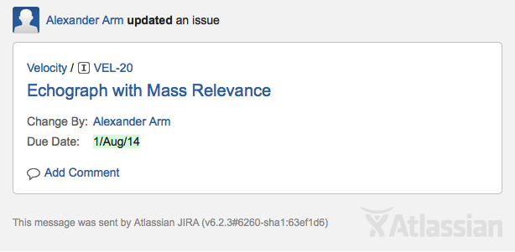
Any time a project card gets moved, everyone assigned to that project will get an email notification in Outlook. That email will have a subject like “FW: [JIRA] Commented: (VEL-20) Echograph with Mass Relevance,” and the body of that email will look like this.

Slide 16



Slide 17



Slide 18
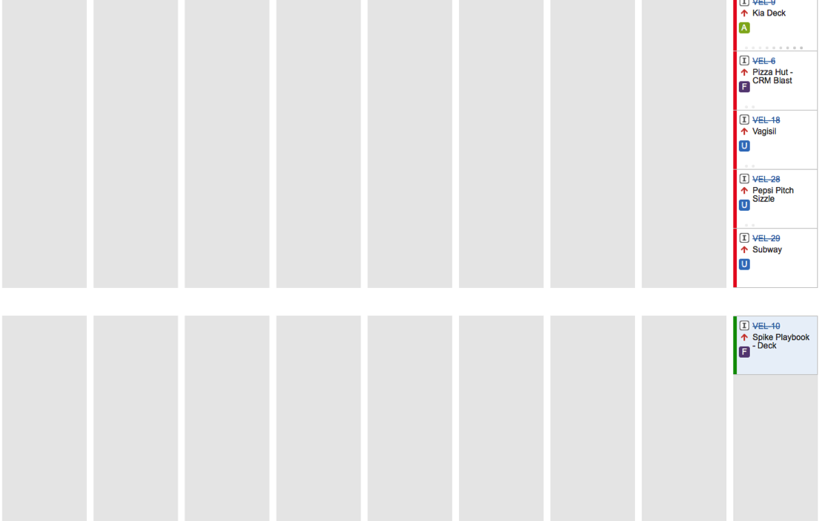
The sidebar (which opens on the right) shows you the second level of details on a project. Click the project title to see it! It looks like this.

Slide 19
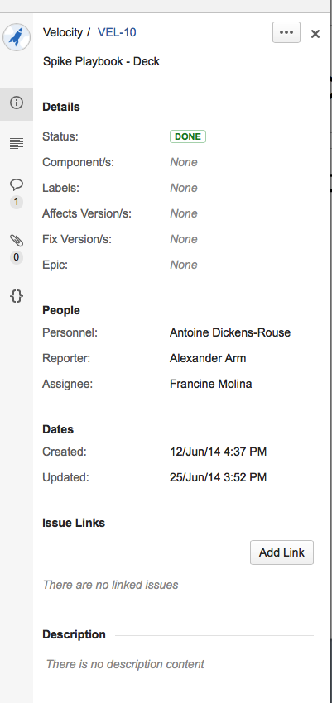
The sidebar has relevant items labeled, such as project title, project name, etc. Reporter and Assignee = project managers; Personnel = you, the creative.

Slide 20
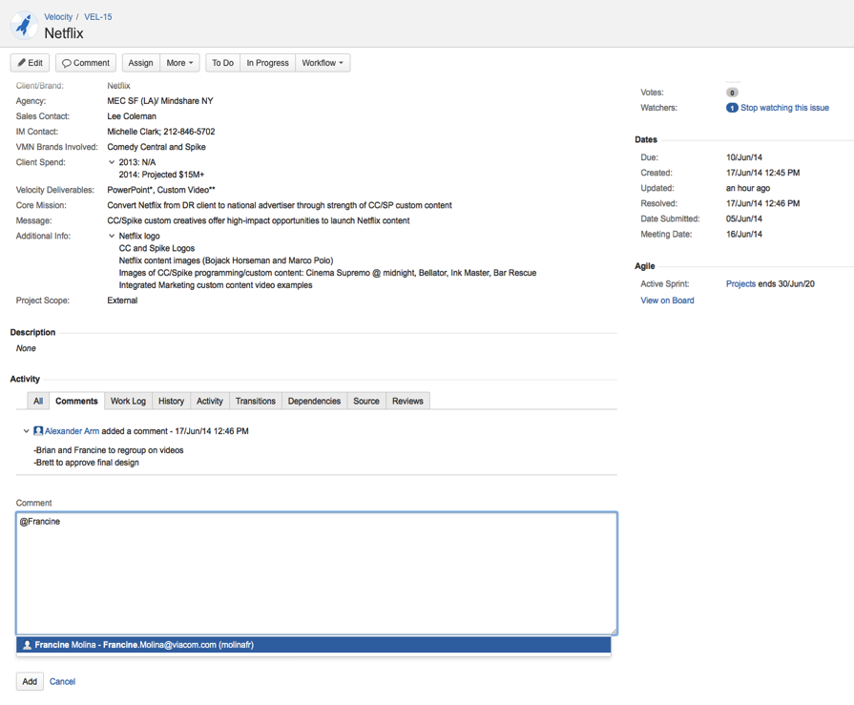
You can tag people in comments, just like on Facebook! @Francine will tag Francine, etc. When you add a comment, it gets emailed to everyone on the project: Reporters, Assignees, and other Watchers. It will look like this.

Slide 21
You must include a link in your comment to the latest version of your work either in its folder on the server, or on MediaSilo.

Slide 22
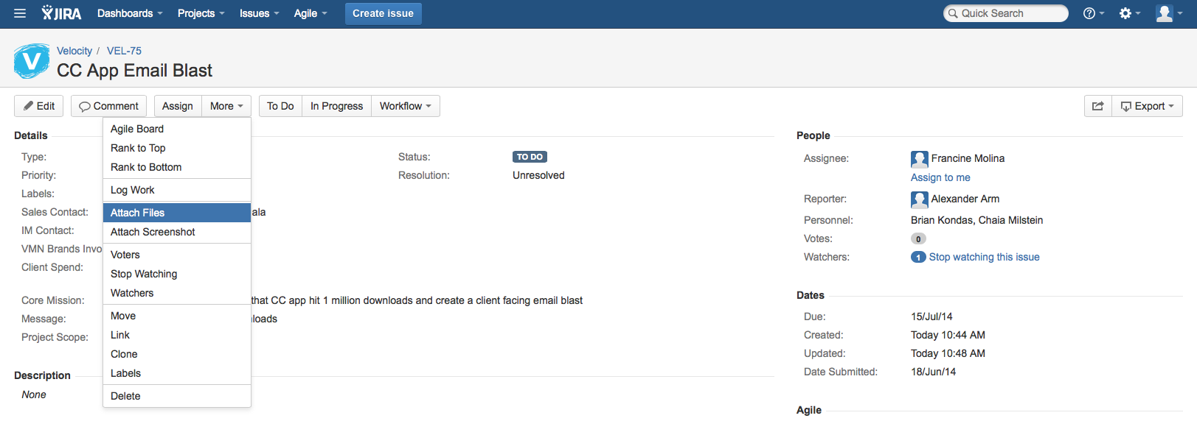
To attach a file, click the More drop-down at the top of the screen and select Attach Files. At end of day, designers will upload screenshots of, or a link to, their work in progress – but there really isn’t server space to upload anything else.

Slide 23
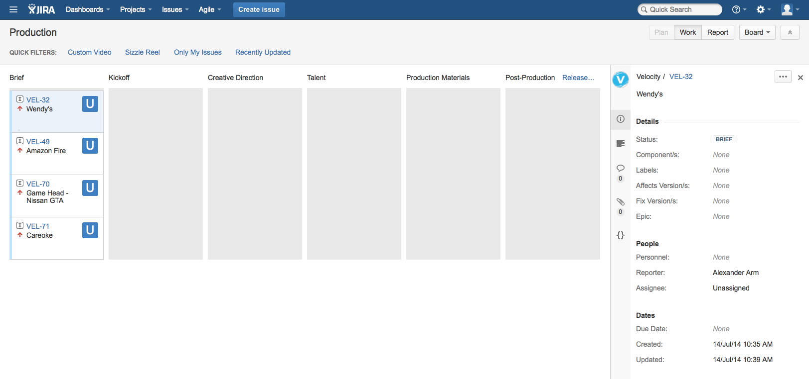
This board works exactly the same as the Velocity Projects board; it is used to track where the project is in terms of production.

Slide 24
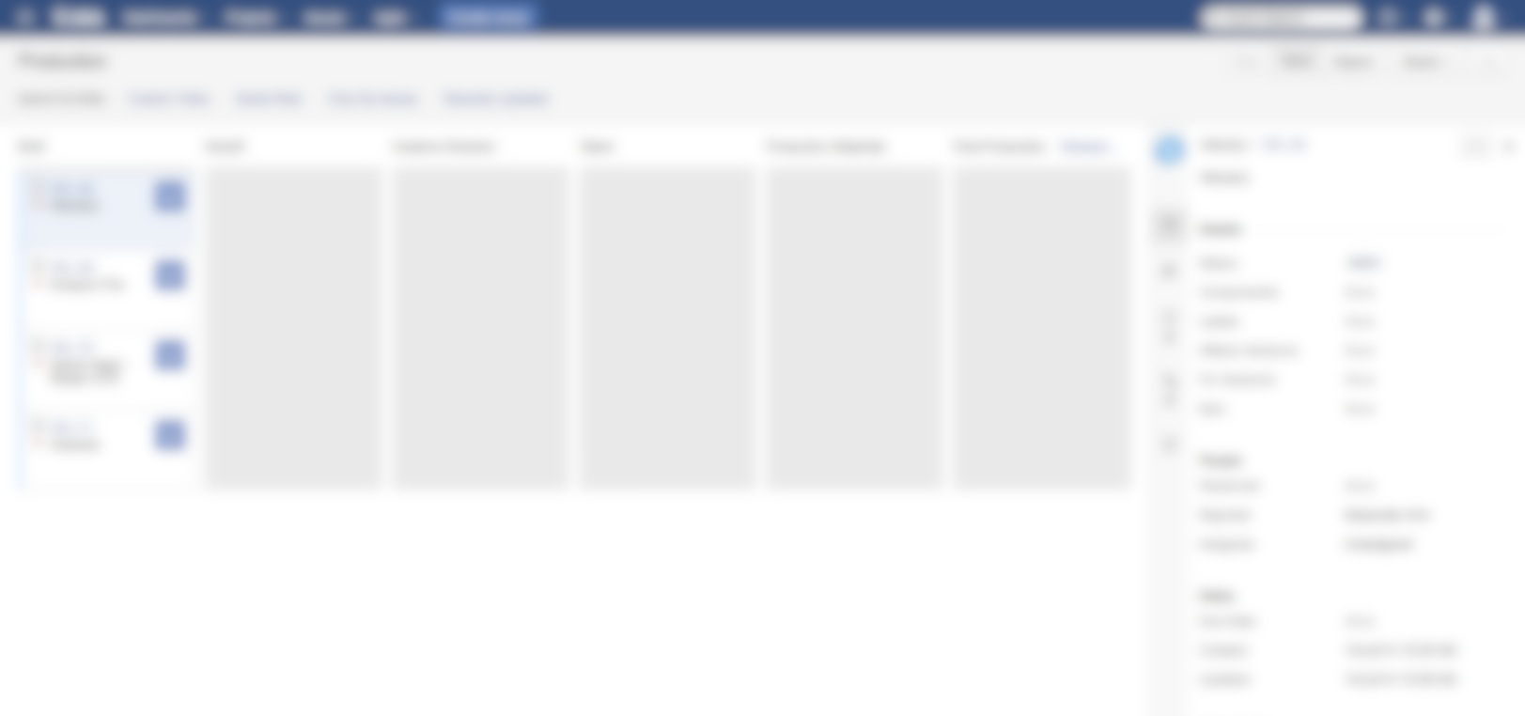
Talent release forms
Location release forms
Guest release forms
Material release forms
Travel and transportation paperwork
Location safety paperwork
All documents relating to a project (release forms, paperwork) should be attached to each project using Jira or placed in MediaSilo with a link on Jira to that specific location.

Slide 25
Assignee – the project manager assigned to an issue (a project)
Board (aka Kanban) – the main place you’ll work, with a group of tasks arranged in columns depicting the workflow
Filter – a keyword that you can click on to sort projects by designer (or by other criteria)
Issue – otherwise known as a project, such as VMAs collateral; we all have issues
Kanban (aka Board) – the main place you’ll work, with a group of tasks on cards arranged in columns depicting the workflow
Participant – anyone involved in an issue
Personnel – this means you: the designer or copywriter assigned to a particular issue (aka project)
Project – a group of boards (for our purposes, all of our projects are housed in the Velocity Projects board)
Reporter – the project manager who creates an issue (a project)
Watcher – anyone who is assigned to or elects to track a particular issue’s project and receive its updates

